Slide 1
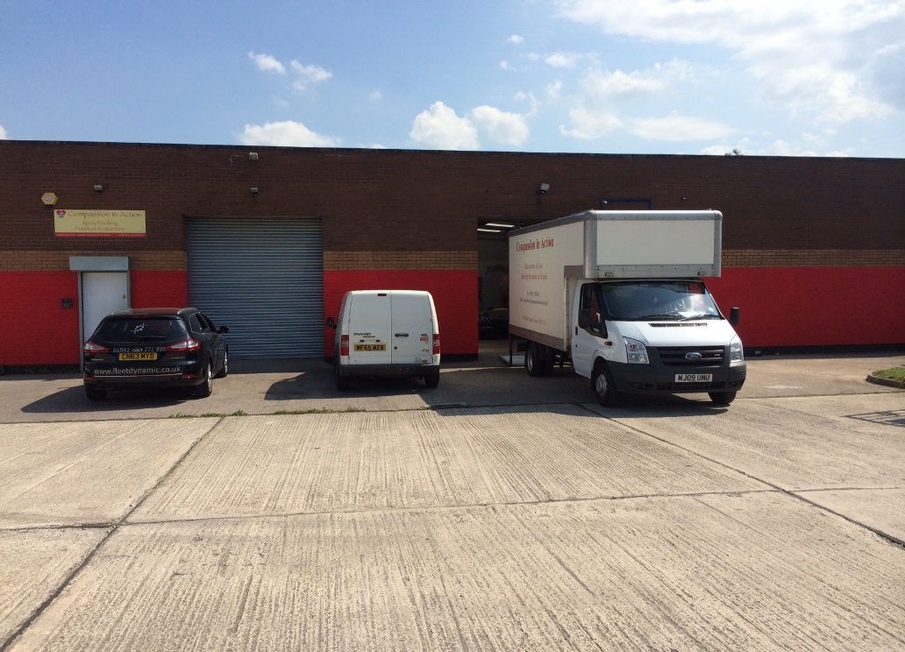
Atherton
Compassion in Action
Our Atherton site is made up of two separate units which both combined make up our furniture and food distribution. Our Delivery & Collections Team and Furniture Restoration Team are based at Atherton and work together to Collect, Refurbish & Deliver to the most needy in the borough
Atherton 1
Food Bank
Furniture Warehouse
Food Hamper Distribution
Furniture Cleaning
Atherton 2
Skills Training
Spray Finishing
Furniture Assembly
Recycling
Furniture Repairs
Furniture, Food, Skills, Employment

Slide 2
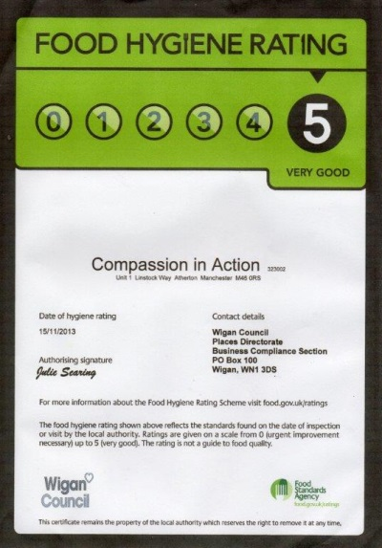
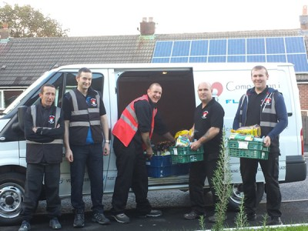
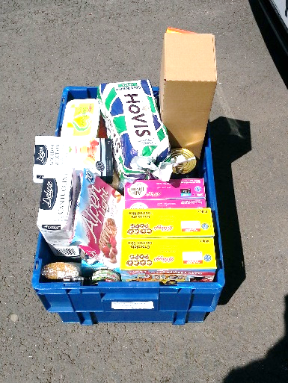
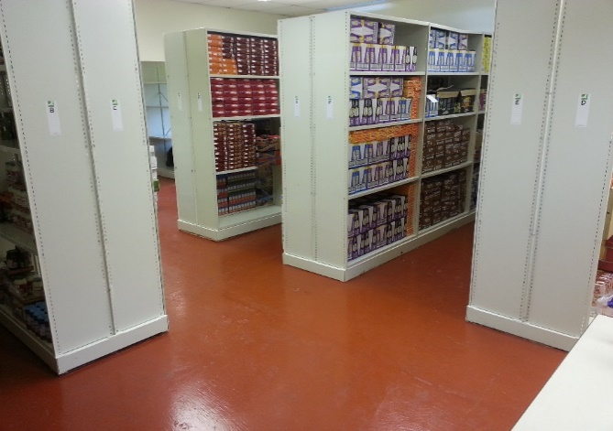
Atherton 1
Food Distribution Centre
Atherton one is the base of our Food Distribution network. It houses our food bank and furniture store.
Hampers are prepared on site and we
co-ordinate our deliveries from the on site offices.
On the 15th November 2013 We received a Level 5 accreditation from the Foods Standards Agency

Slide 3
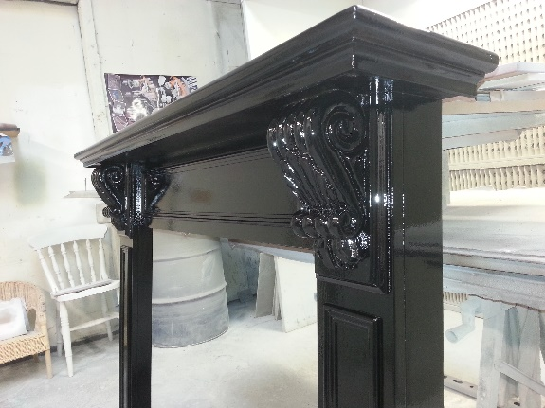
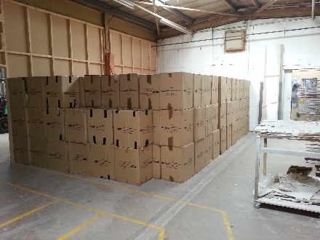
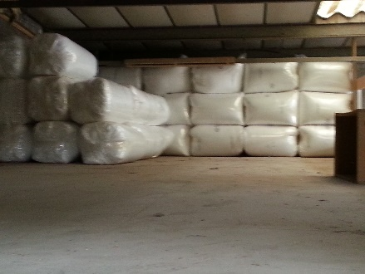
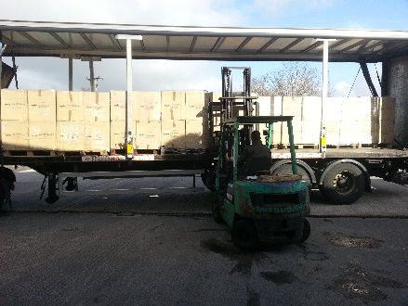
Atherton 2
Food Restoration Centre
Atherton Two is where the furniture is prepared for distribution.
It houses our spray shop and furniture repair area as well as our joinery section. We have skilled staff, volunteers and work placements working together to create furniture packages.
We assemble, clean, repair and store furniture before delivery. This may require specialist spray finishing or building up items from flat pack. We source our Olympic beds, mattresses and cabinets in high volume. This requires warehouse management and constant monitoring of stock.

Slide 4
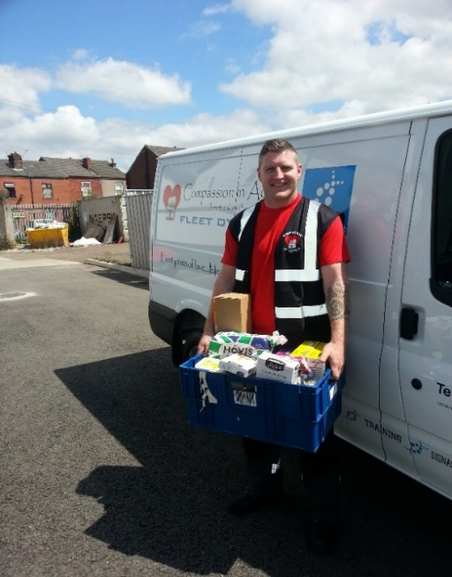
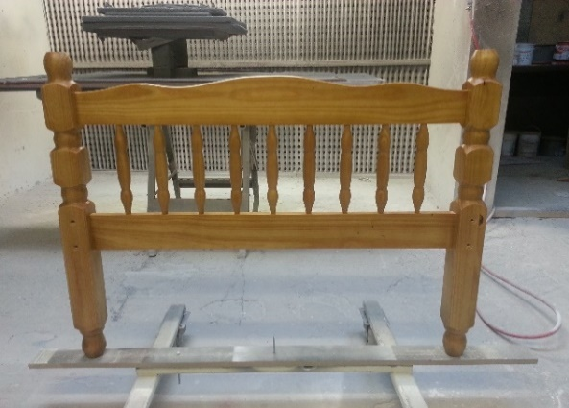
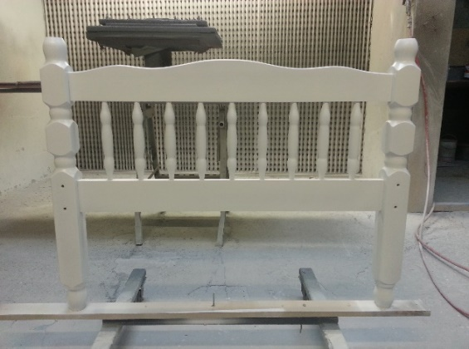
From
1st February 2014 to 30th April 2014
We delivered 845 Food Hampers and 191 Furniture Packages throughout the Wigan Borough

